Slide 1
Simple Stupid Rover
Robbe Elsermans, Adam Hejduk, Thomas Kramp

Slide 2

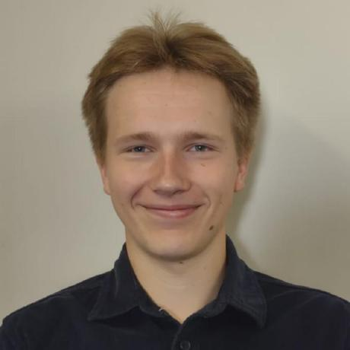

Adam Hejduk
Robbe Elsermans
Thomas Kramp
Environmental Sensing
Energy harvesting
Energy output management
Soldering man
Project Manager
Energy Awareness
BLE intercommunication
Power Profiling
Gyroscope
LineBot
LoRa
Dashboard
Notes:
Meet the team,
Adam Hejduk was responsible for
environmental sensing
Energy harvesting
Energy Output management
Soldering man
Robbe Elsermans was responsible for
Lead the project
Energy awareness
BLE ontercommunication
Power Profiling
Thomas Kramp was responsible for
Gyroscope sensor
LineBot actuation
LoRa communication
And the dashboard

Slide 3




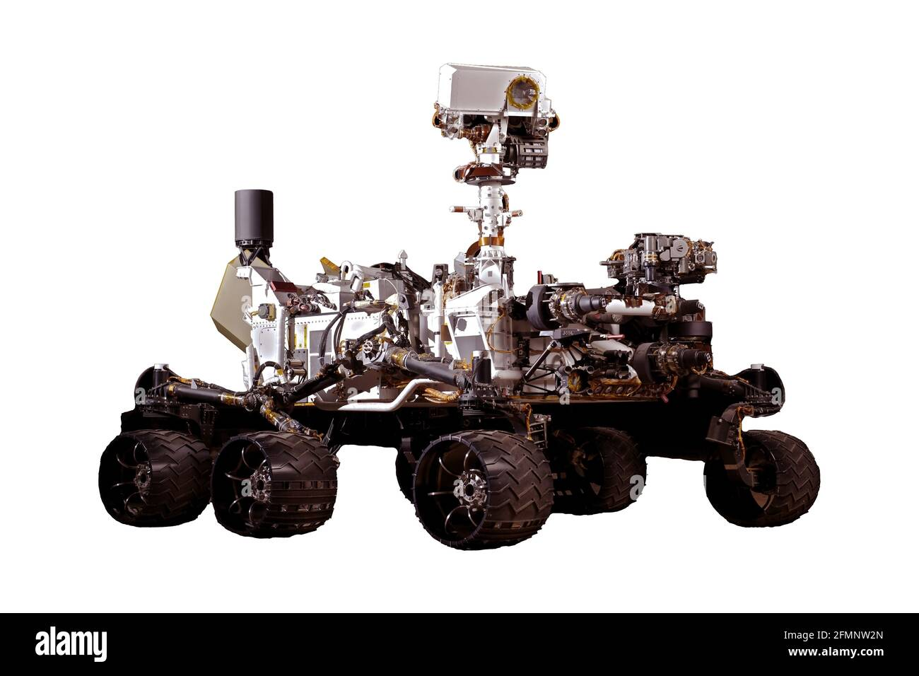

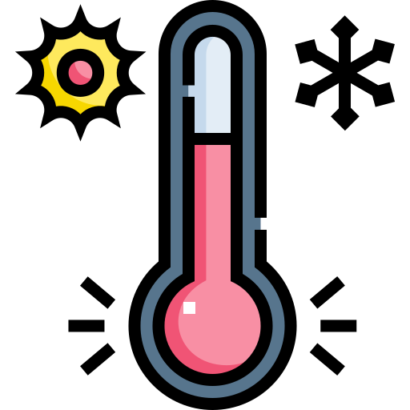
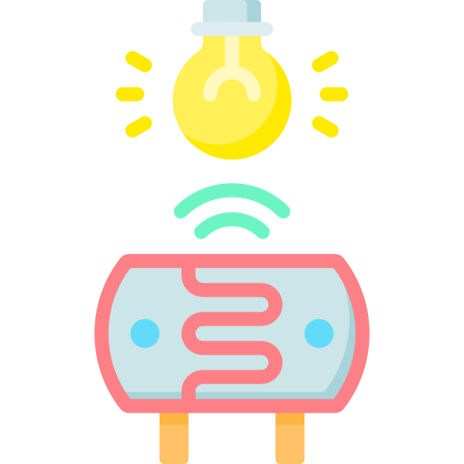

Concept
Notes:
As humanities interest in Mars grows, an understanding of its weather pattern on different locations is needed.
One of the greatest challenges that the planet provides are the frequent dust storms.
This project will try to monitor the weather phenomenon (such as temperature, humidity, light, ...) to predict such storms, for future mars explorations.
The goal is to have independently rovers that drive around the mars environment to collect the following data:
(Klick) Temperature, light, humidity etc. of the environment in both an idle state and when the dust storms occur.
(Klick) The frequency of the dust storms.
(Klick) The scale of the dust storms.
(Klick) The orientation of our rovers.
(Klick) The communication protocols used are LoRa and BLE.
(Klick) All powered by harvested energy.

Slide 4
Concept
Notes:
The concept in a nutshel:
We have a rover somewhere on Mars. On Mars, a gateway is present in order to deploy a LoRa network.
As said before, this rover can act independently.

Slide 5
Concept
Notes:
Both rovers drive independetly and by random drives, 2 rovers can come closer to each other.

Slide 6

Concept
Notes:
They can interchange their data over BLE. This includes direction and measured data. Later more on that.
So based on this direction data, both rovers know where their headings are pointed.

Slide 7
Concept
Notes:
Therefore, they know where to go and where not to go to avoid craching to each other.

Slide 8
Concept
Notes:
In this case, the entered rover knows he can not continue its path forward, but must diverge from his intended path.

Slide 9
System Description
Notes:
Our system represented on a higher level

Slide 10
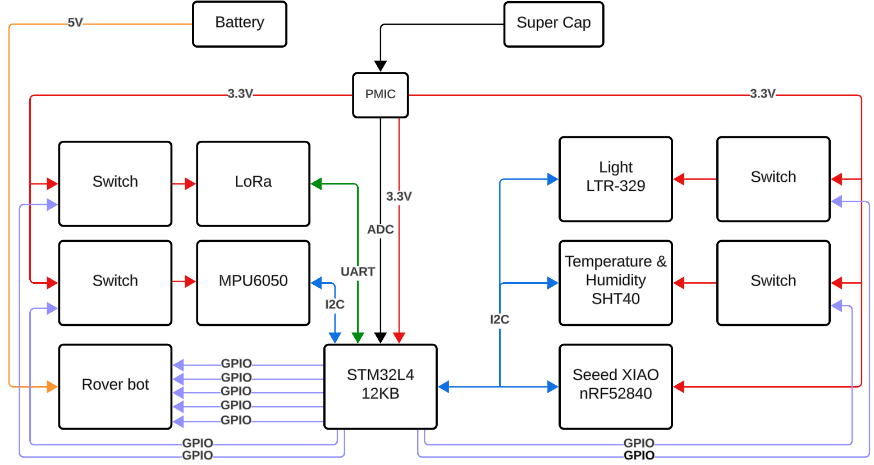
Rover system
Notes:
First, we have our brain of the SSR. This is the STM32 L412KB which has excellent power consumption when brought down in low power.

Slide 11
Rover system
Notes:
The BLE-module nRF52840 which is often used in diy projects to provide a Bluetooth Low Energy and even the chip itself which is low energy.
It even has a dedicated Power Management Unit in the chip that acts dynamically without user intervention.

Slide 12
Rover system
Notes:
The LoRa-module is a module where an STM32 is used in combination with a LoRa chip.

Slide 13
Rover system
Notes:
Our environmental sensing modules:
the LTR-329 for light,
SHT40 for temperature and humidity,
and the MPU6050 for acceleration and movement detections.

Slide 14
Rover system
Notes:
The LoRa is connected over UART.

Slide 15
Rover system
Notes:
An ADC is used for determining the remaining voltage over the super cap

Slide 16
Rover system
Notes:
I2C is our main used protocol to communicate with different modules. Even more, our intention was to communicate only over I2C but time didn't give us any favors.

Slide 17
Rover system
Notes:
Therefore, we used some bare GPIO-pins in Output mode for various tasks such as

Slide 18
Rover system
Notes:
Switching the power on and off for high consumer-modules that are not that power efficient in standby.

Slide 19
Rover system
Notes:
Controlling the movement of the rover by "hacking" the joystick pins.

Slide 20
Rover system
Notes:
Our energy source will be a super capacitor of 1F single cell.

Slide 21
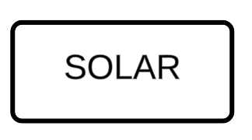
Rover system
Notes:
Which is charged by solar panels

Slide 22
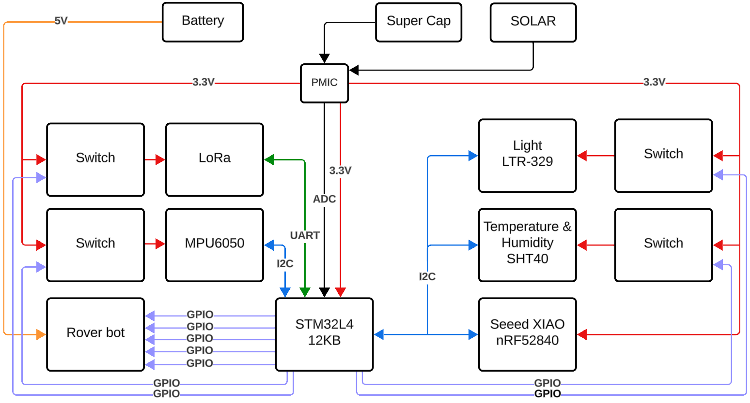
Rover system
Notes:
Both are managed by the Power Management IC.
This IC will power all our modules and switches.

Slide 23
Rover system
Notes:
Where the rover will be powered by a different battery due to the high energy consumption.

Slide 24
Rover system
Notes:
This brings us to our system diagram

Slide 25
LPPAN communication
BLE
Notes:
LPPAN communication or rover intercommunication

Slide 26

BLE Communication system
e
Advertise
Beacon
Scanner
Notes:
Our intercommunication is based on a beacon and scan modes. Here, the beacon transmits something and the scanner can recognize this beacon.

Slide 27
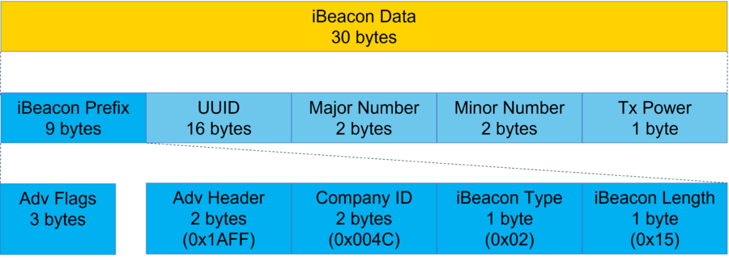
BLE Communication system
Advertise -> IBeacon
Notes:
The beacon format used is that of an iBeacon Data packet. This is a 30 bytes packet which consists of

Slide 28
BLE Communication system
Advertise -> IBeacon
Notes:
A prefix which is not tampered with. It is set to the default bits.

Slide 29
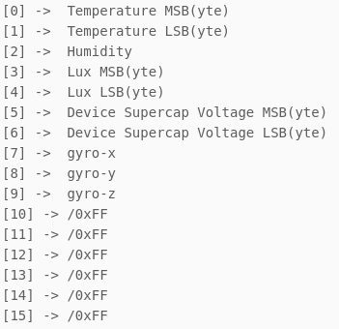
BLE Communication system
Advertise -> IBeacon
Notes:
The UUID or Universally Unique IDentifier that consists of 16 bytes.
10 of these bytes are used to transmit certain information such as
the environmental sensing readings,
the devices supercap voltage and
the relative placement of the rover.
The remaining bytes are set to a default value.

Slide 30
BLE Communication system
Advertise -> IBeacon
Notes:
Next, the major number is 2 bytes wide and the purpose is altered by giving the first byte,
the beacon identifier. With this, the scanner knows what kind of beacon this is.
And the second byte is used to identify the rovers' ID.

Slide 31
BLE Communication system
Advertise -> IBeacon
Notes:
The minor bytes are set to zero and are not used.

Slide 32
BLE Communication system
Advertise -> IBeacon
@ 1 m
Notes:
Lastly, the Tx Power or RSSI which gives an indication of the received power gain with respect to 1 meter distance. This can be used to have an estimate on the distance between 2 rovers.

Slide 33
BLE Communication system
Orientation
Notes:
We can use this intercommunication to determine the relative orientation and distance of 2 independently driving rovers.

Slide 34
BLE Communication system
Optimal Transmission
Notes:
And we can use the beacon data to determine who transmits what.

Slide 35

BLE Communication system
Optimal Transmission
Notes:
I'll come back to this when we are discussing energy awareness.

Slide 36
LPWAN Communication
LoRa

Slide 37

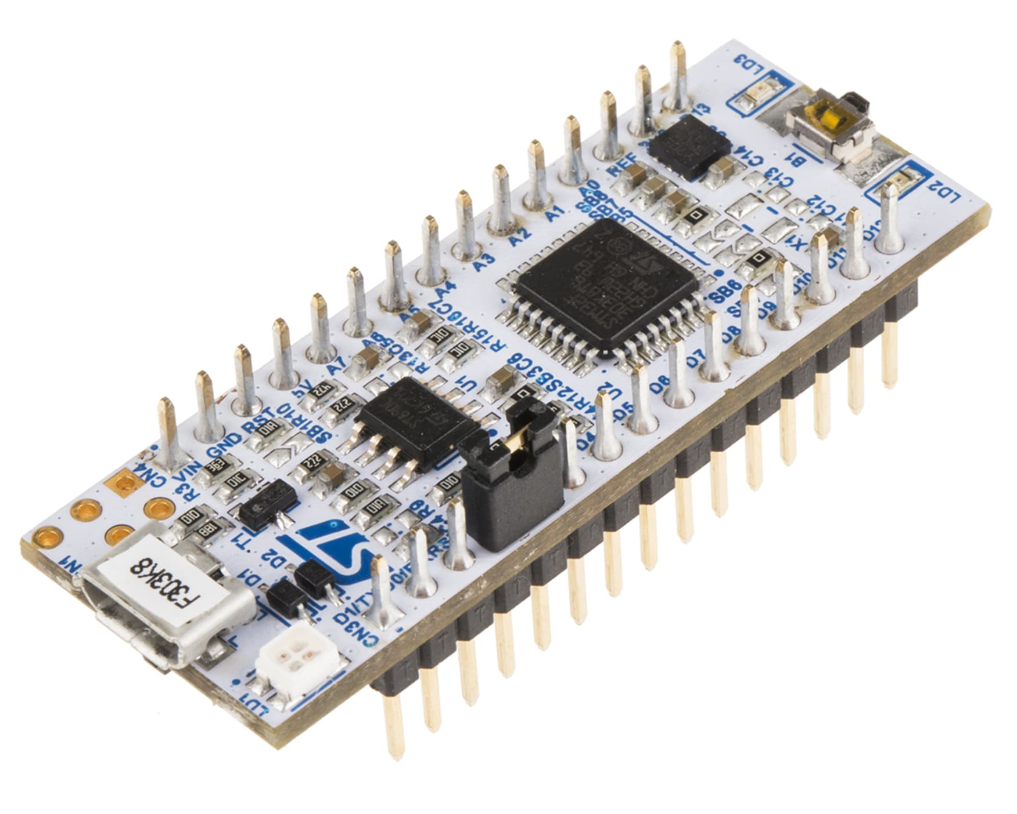
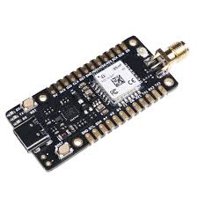

LoRa Communication system
AT-command
LoRa
MQTT
Notes:
The base module to server setup is as follows:
- The brain module will collect all its data from its sensors
- It will send this data to the servers, via a LoRa module (with AT commands).
- The LoRa module will repeat the measage x-amount of times, before it is received at TTN.
- TTN has a MQTT server active to send the data to any appropriate broker.
- The Node-Red server will have a broker listening on TTN, and collect its data to store and show on the dashboard.

Slide 38
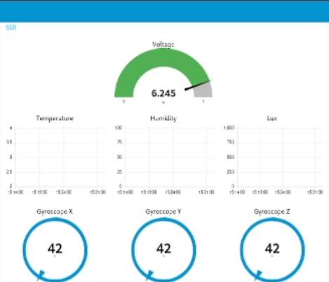
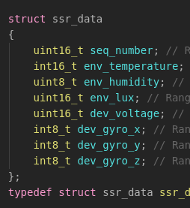
Data to dashboard
Notes:
Example of how the data will be shown

Slide 39
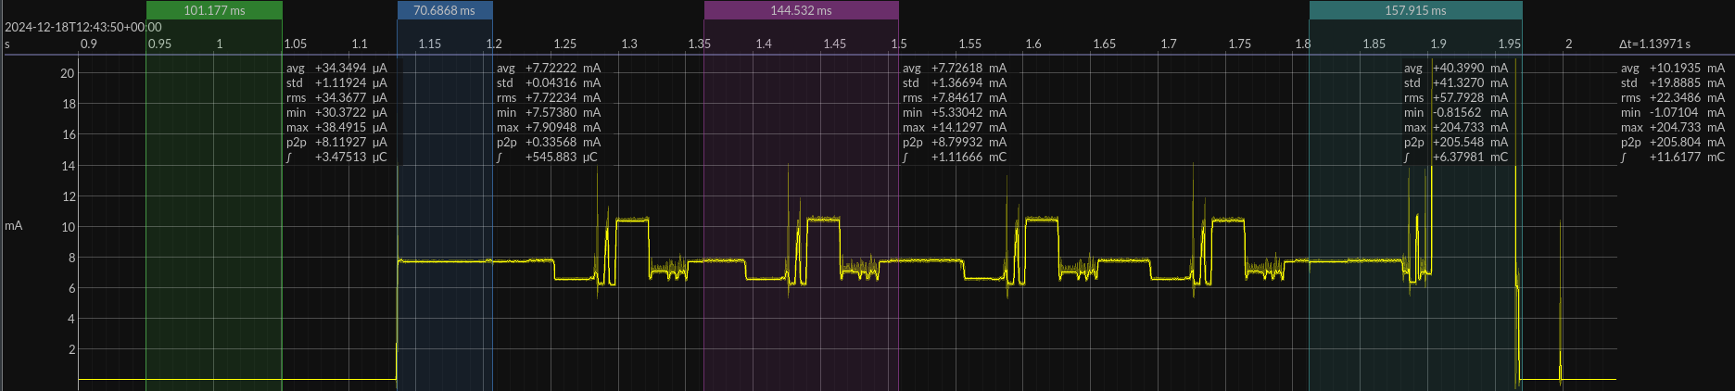
How it should have worked
Sleep
Wake Up
Settings
Transmit
Sleep
Notes:
The way the lora transmisions should have worked, was that the module would
1) sleep while not in use
2) wake up on command
3) register the settings
4) transmit the message
5) go back to sleep
Though there were a couple of mishaps, leading to some tweaks:
- Repeated transmissions
- Active time during sleep
- Reinitialize settings after long sleep

Slide 40
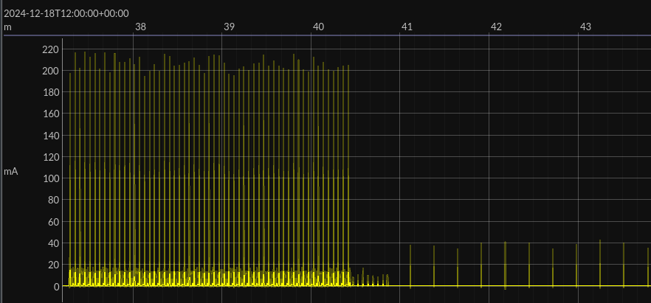
Repeated transmissions
Notes:
In the beginning we had the problem that LoRa module would send a message to TTN, but that it wouldn't be received.
Even though a day prior, with the same settings, the device could send at least once.
We've solved this by repeating the same message multiple times, which eventually made it so TTN received the message once.
With some testing we've found that the amount of repeats lies between 55-60 times (if there is at least a delay of 3.2 ms between transmissions).
That is why between transmissions we set the device to deep sleep. This didn't effect the perform, only lessened the power consumption.
The goal is now to perform the sensor measurements between the repeated transmisions.

Slide 41
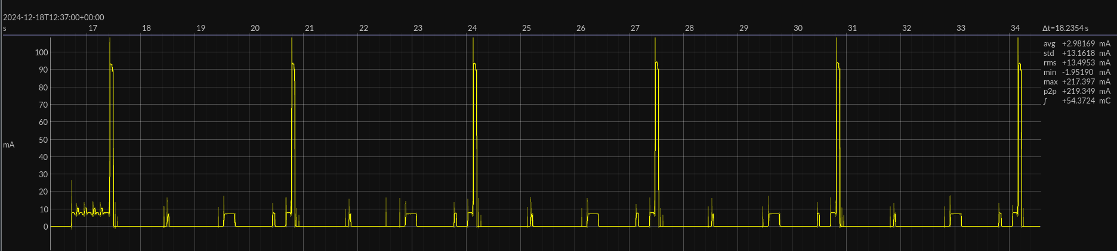
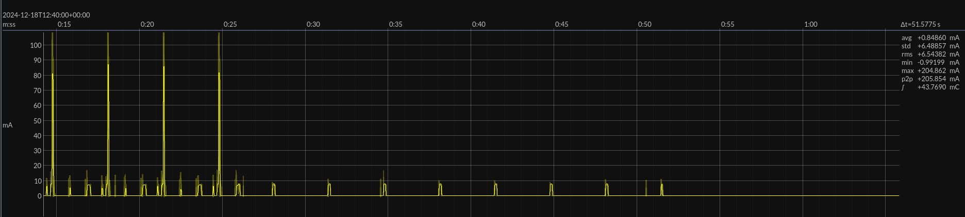
Active time during sleep
Notes:
The first image shows how the LoRa module wakes up from its sleep between transmissions, only to fall asleep again.
The odd thing is that these wake ups always occur in groups of 3 between the repeated transmissions.
They are most likely the RX messages of the AT commands.
The second image shows how the LoRa Module wakes up after fully being set to sleep.

Slide 42


Reinitialize settings after long sleep
Notes:
Note; The red line is drawn since the original fimage couldn't be loaded in (jouloscope couldn't load a 20GB file).
After a long sleep the settings would seamingly become lost, making it so there were no transmissions.
This did not occur for the sleep between repeated transmissions.
To solve this, we reinitilized the settings after waking up from a long sleep.

Slide 43
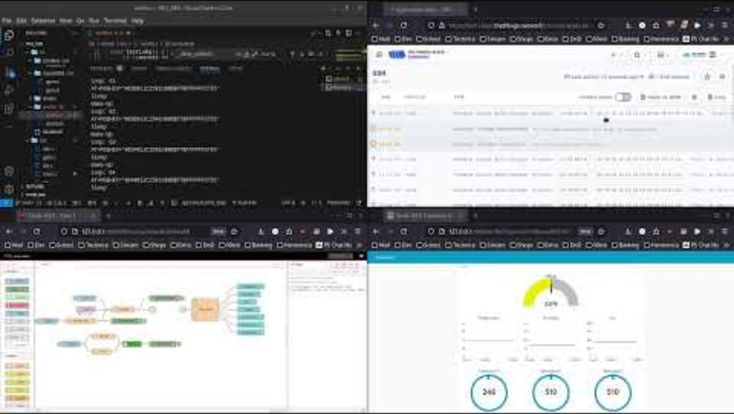
Demo

Slide 44
Sensing
Notes:
STM communicates with Enviromental sensors with I2C protocol.
Agruably spent most of my time on this. Programming the stm to communicate with the sensors via HAL libary with I2C protocol
Didn't program in a while
How to print into serial monitor with UART
Memory access problems
Since SHT40 doesn't have a standby mode and LTRs standby mode is not as effective as we thought, we would idealy have load shitches that would start powering the sensors when needed
Our robot is a scouting robot,

Slide 45
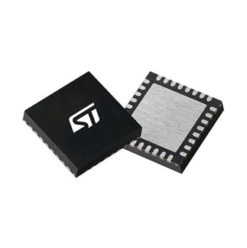
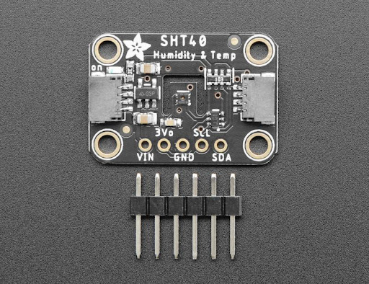
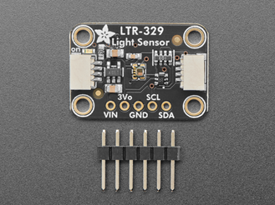
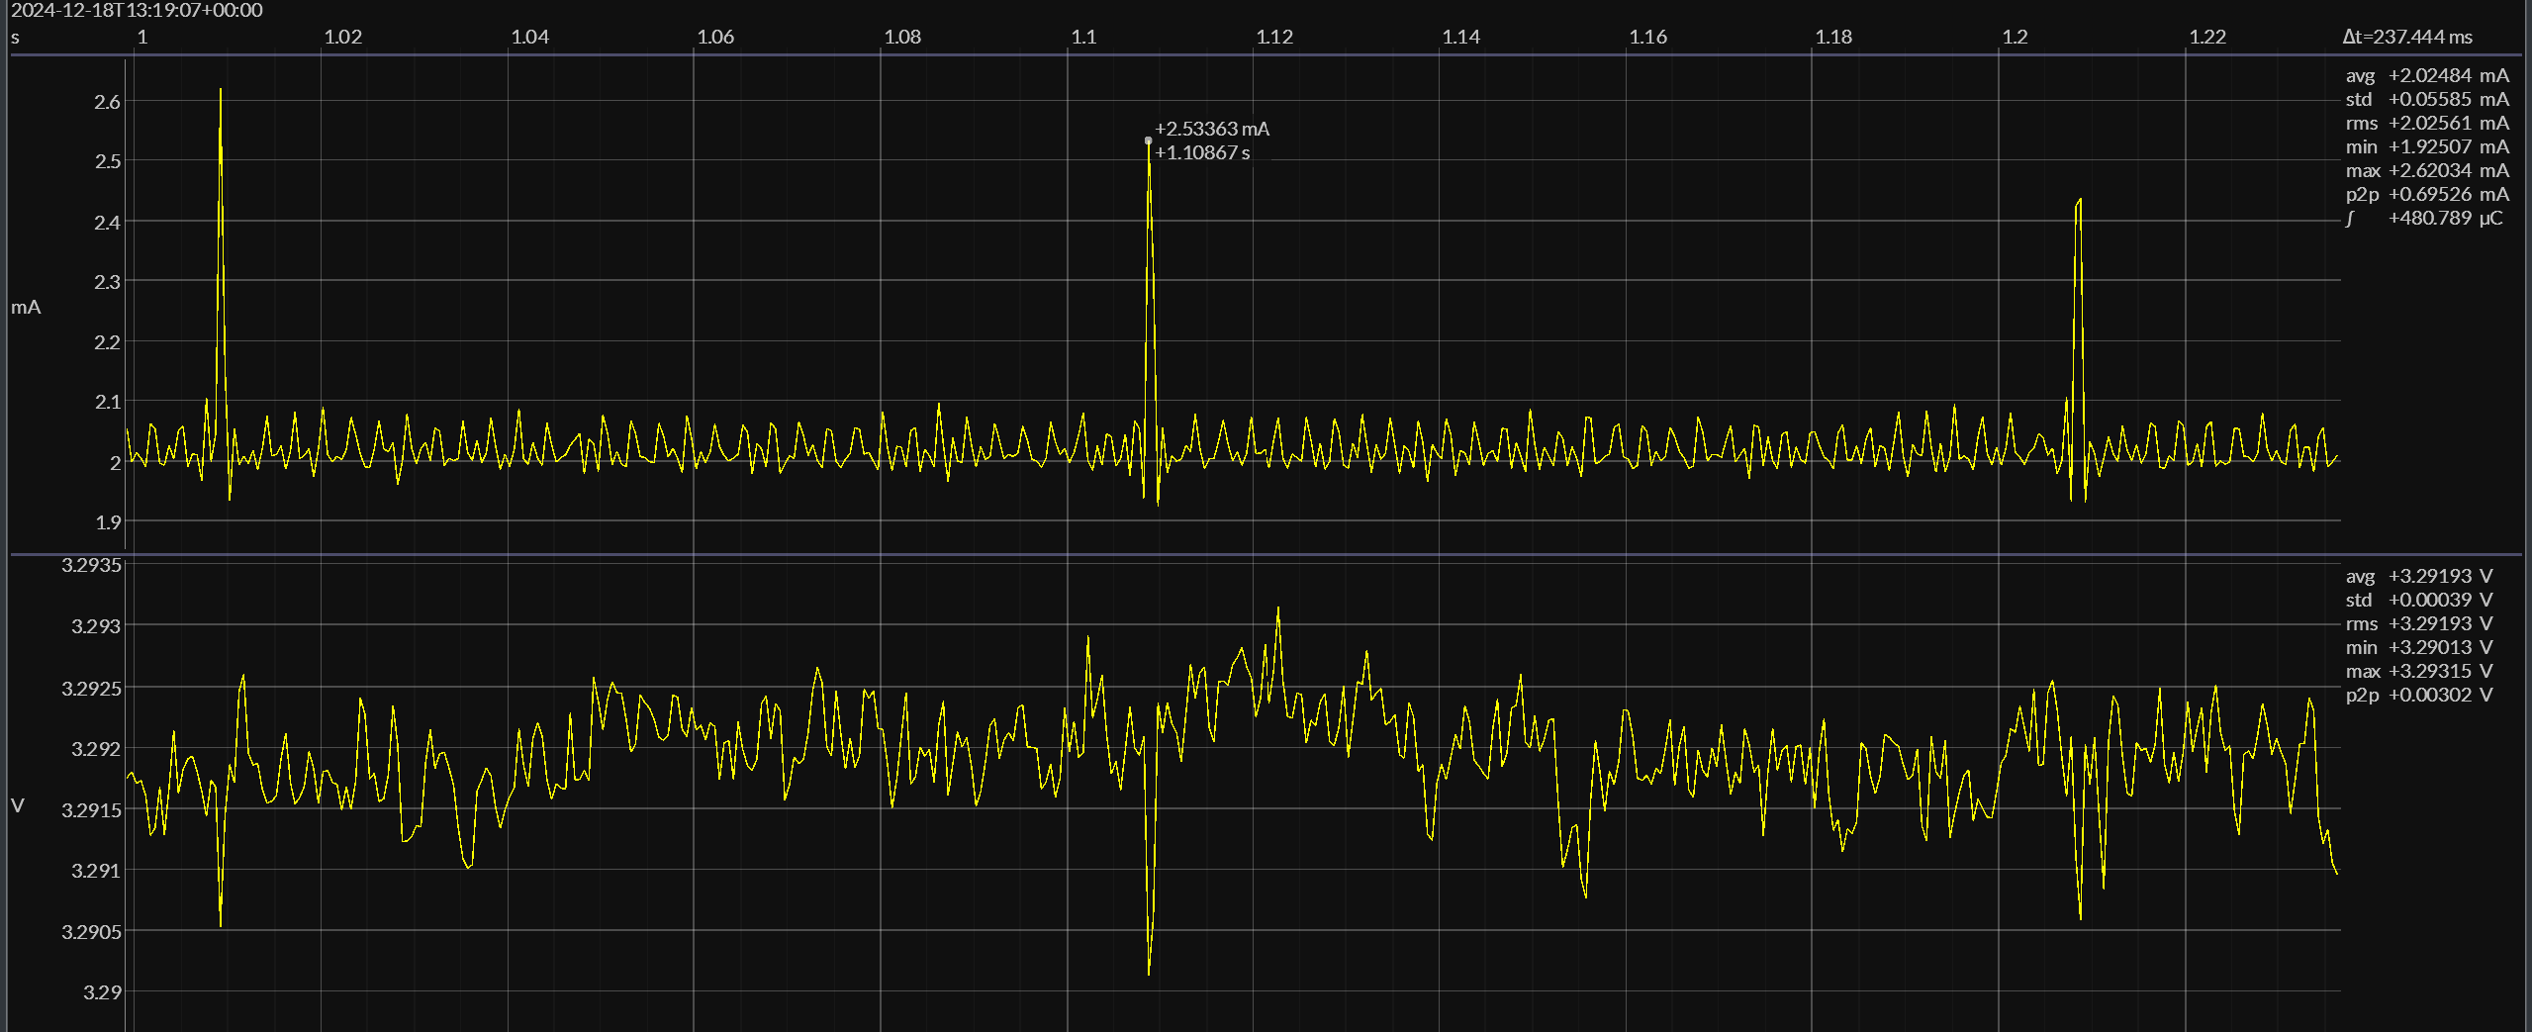
Sensing (SHT40)
Notes:
STM communicates with Enviromental sensors with I2C protocol.
Agruably spent most of my time on this.
Didn't program in a while
How to print into serial monitor with UART
Memory access problems
Since SHT40 doesn't have a standby mode and LTRs standby mode is not as effective as we thought, we would idealy have load shitches that would start powering the sensors when needed

Slide 46
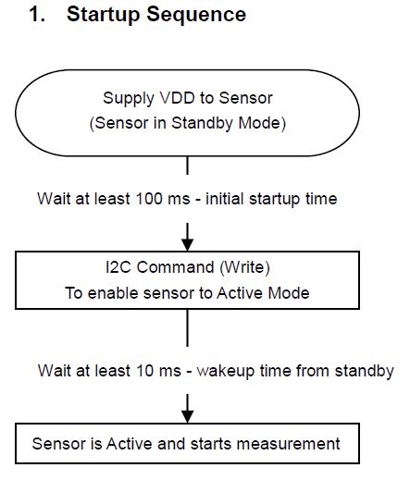
Sensing (LTR-329)
STM communicates with Enviromental sensors with I2C protocol.
0.01 lux – 64k lux
Notes:
This sensor
converts light intensity to a digital output signal
capable of direct I2C interface
from 0.01 lux to 64k lux

Slide 47
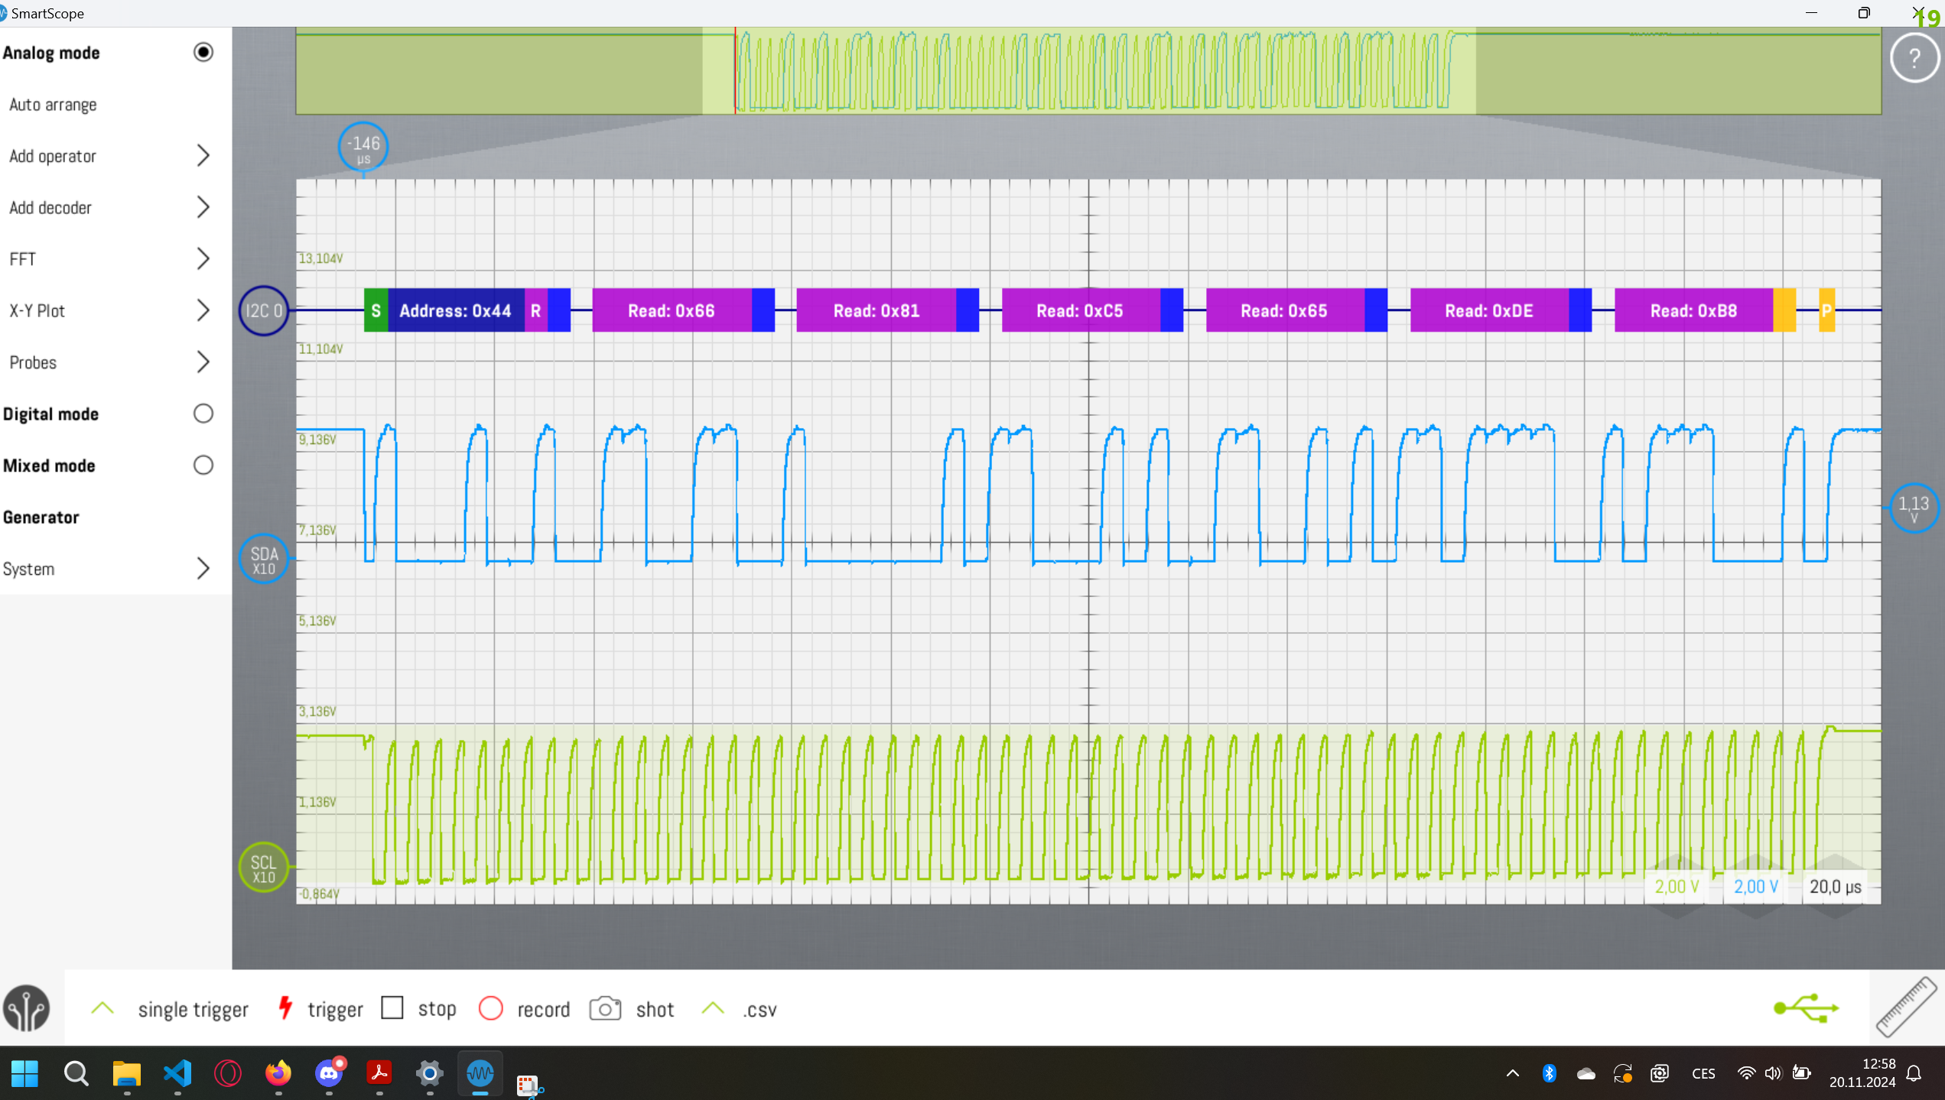
Standbymode

Slide 48
Standbymode

Slide 49
Standbymode

Slide 50
Standbymode

Slide 51
Standbymode

Slide 52
Standbymode

Slide 53
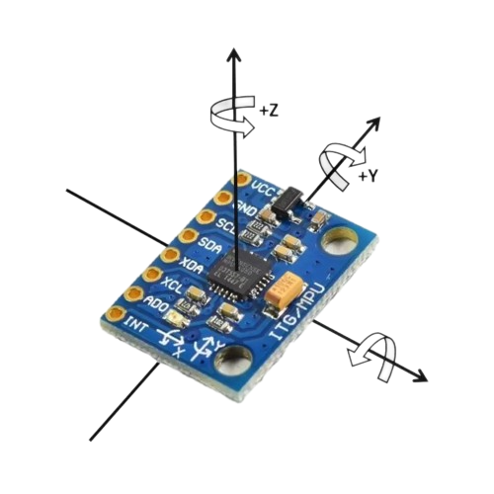
Sensing (PMU6050)
STM communicates with gyroscope via I2C
Temperature and acceleration sensors deactivated
The gyroscope measurements are a difference measurement
High sleep mode consumption (1.4mA)
Image from: https://user-images.githubusercontent.com/107638696/241324971-43b8fe88-447d-4c2d-9296-4b3aaa50f4ce.png
Notes:
The PMU6050 isn't a useful sensor for the scope of this project. This is due to 2 factors:
- It consumes much energy even while sleeping
- The received data is mostly useless if it cannot be stored.
The measured data of the gyroscope sensor in the MPU6050, only measures the difference in rotation at a specific moment.
If we don't measure while it is rotating it won't know it has been rotated.

Slide 54
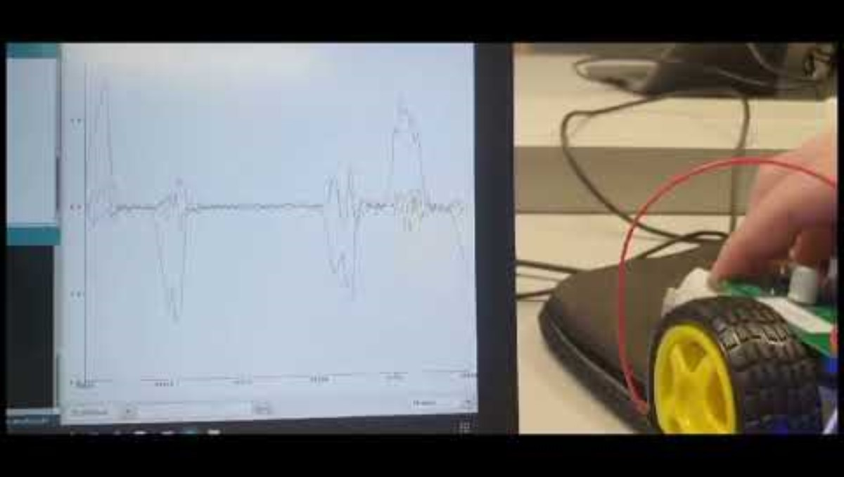
Sensing (PMU6050)

Slide 55
Energy Harvesting

Slide 56
Energy Harvesting
I2C _HAL_ libary
PRogRaMinG ....
Notes:
Topics I want to expand on ?!

Slide 57
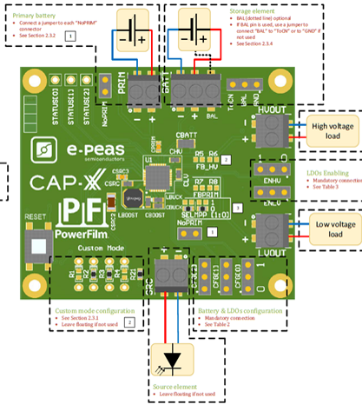


Energy harvesting so far and expectations
Notes:
We recived one faulty energy harvesting module but since we workwith an idea that each of our rovers work independently it did not stop us from advancing with the project.

Slide 58
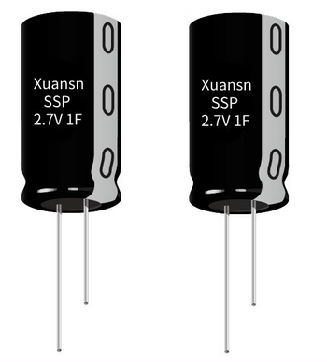
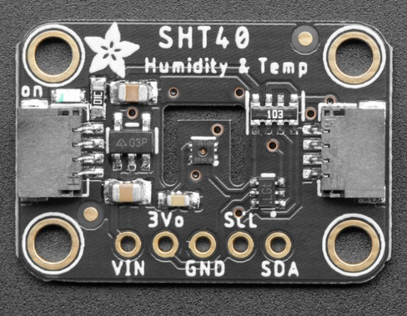
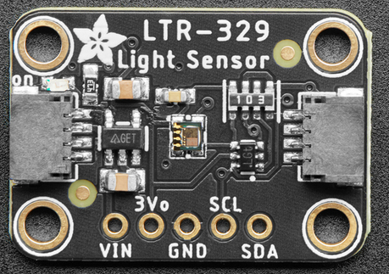
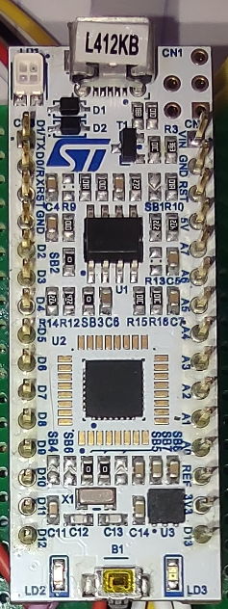
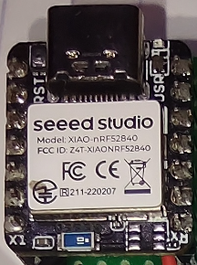
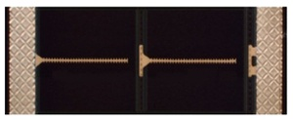
The goal
SHT40(1.08 - 3.6)V
LTR-329(2.4 - 3.6)V
BLE(1.7 - 3.3)V
STM(3 - 3.6)V
Notes:
We want to power as many peripherals as possible
- Inside Solar Panel
- 2x 2,7V1F Supercap
- AEM10941 Evaluation Kit
We ended up using E.H.M. with one solar panel and two SuperCaps in series.
(Using two different solar panels can cause Current imbalance where "stronger" solar panel will force current to the weaker one, making the charging actually slower and could damage the system or the solar panels)
There is a bit of a problem with using two SuperCaps because of voltage division between them... but more on that later.

Slide 59
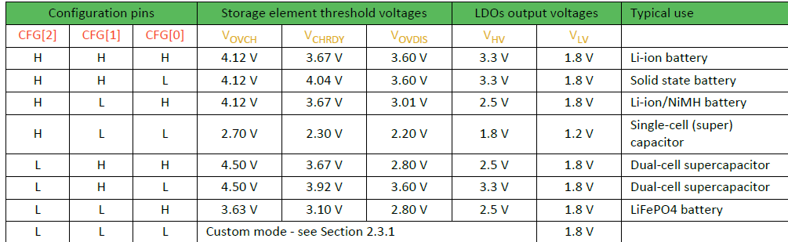


Do we even have enough power ??? ^^
Notes:
E.H.M. has adaptable configuration preset
We used Dual-cell supercap, which works in a way that Storage is being charged by S.P.
Outputs are open when Storages reaches 3.92V and are open until Voltage reaches 3.6V.
Storage can be overcharged up to 4.5V
And to power STM32 with every other prephiral we use Hight Voltage outpus (3.3V)

Slide 60
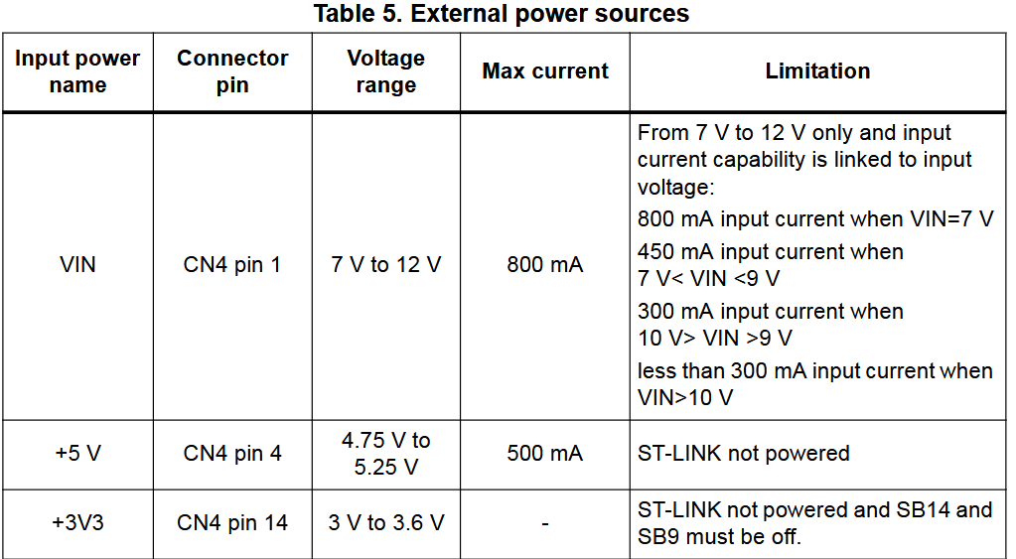
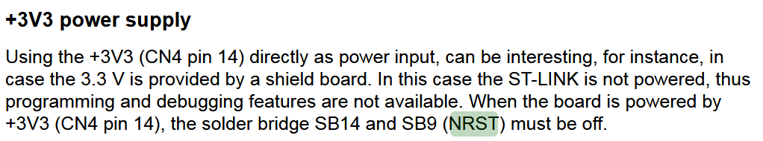
Energy harvesting so far and expectations
Notes:
To power an STM32 through power supply of 3V3 we have to configure the board by unsoldering SB14 and SB9.
But this disables programing features of the board.

Slide 61
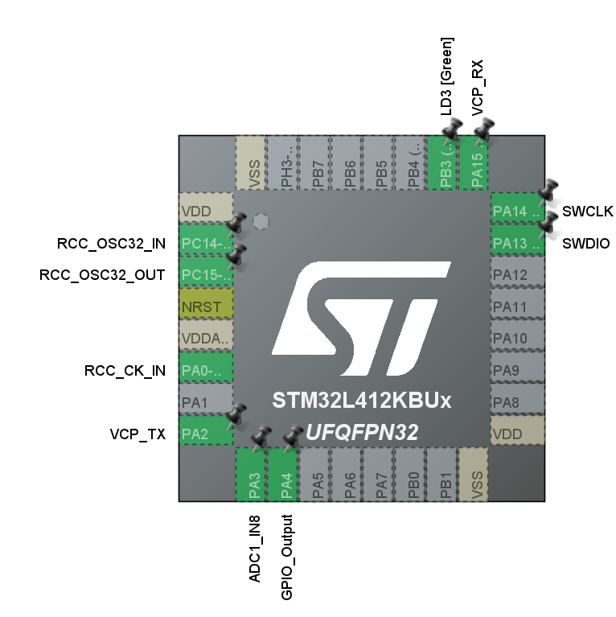
Decision making
C B A
ADC
Notes:
We are able to measure voltage thanks to ADC on STM32 microcontroller
STM reads this Voltage and changes states of proccesses according to how much more power is avalible.
Later on enegry awareness...
The idea: Rover would behave according to its Energy avalible
ADC reads the voltage on point B , because if the voltage on ADC would acceed 3.3V it could damage the STM32. And this way it would only possilby reach 2.7V.
We didn't consider the fact that voltage between two same capacitors is not distributed equally. That is something to be considered in future impruvements.

Slide 62
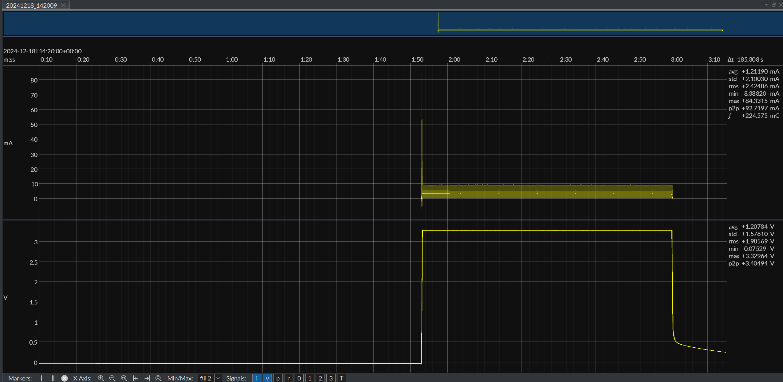
Voltage output measurement
Notes:
here we can see what happens when HighOut opens ( Voltage on caps reaches 3.92V )
Lives for about a minute with only sensors connected.

Slide 63
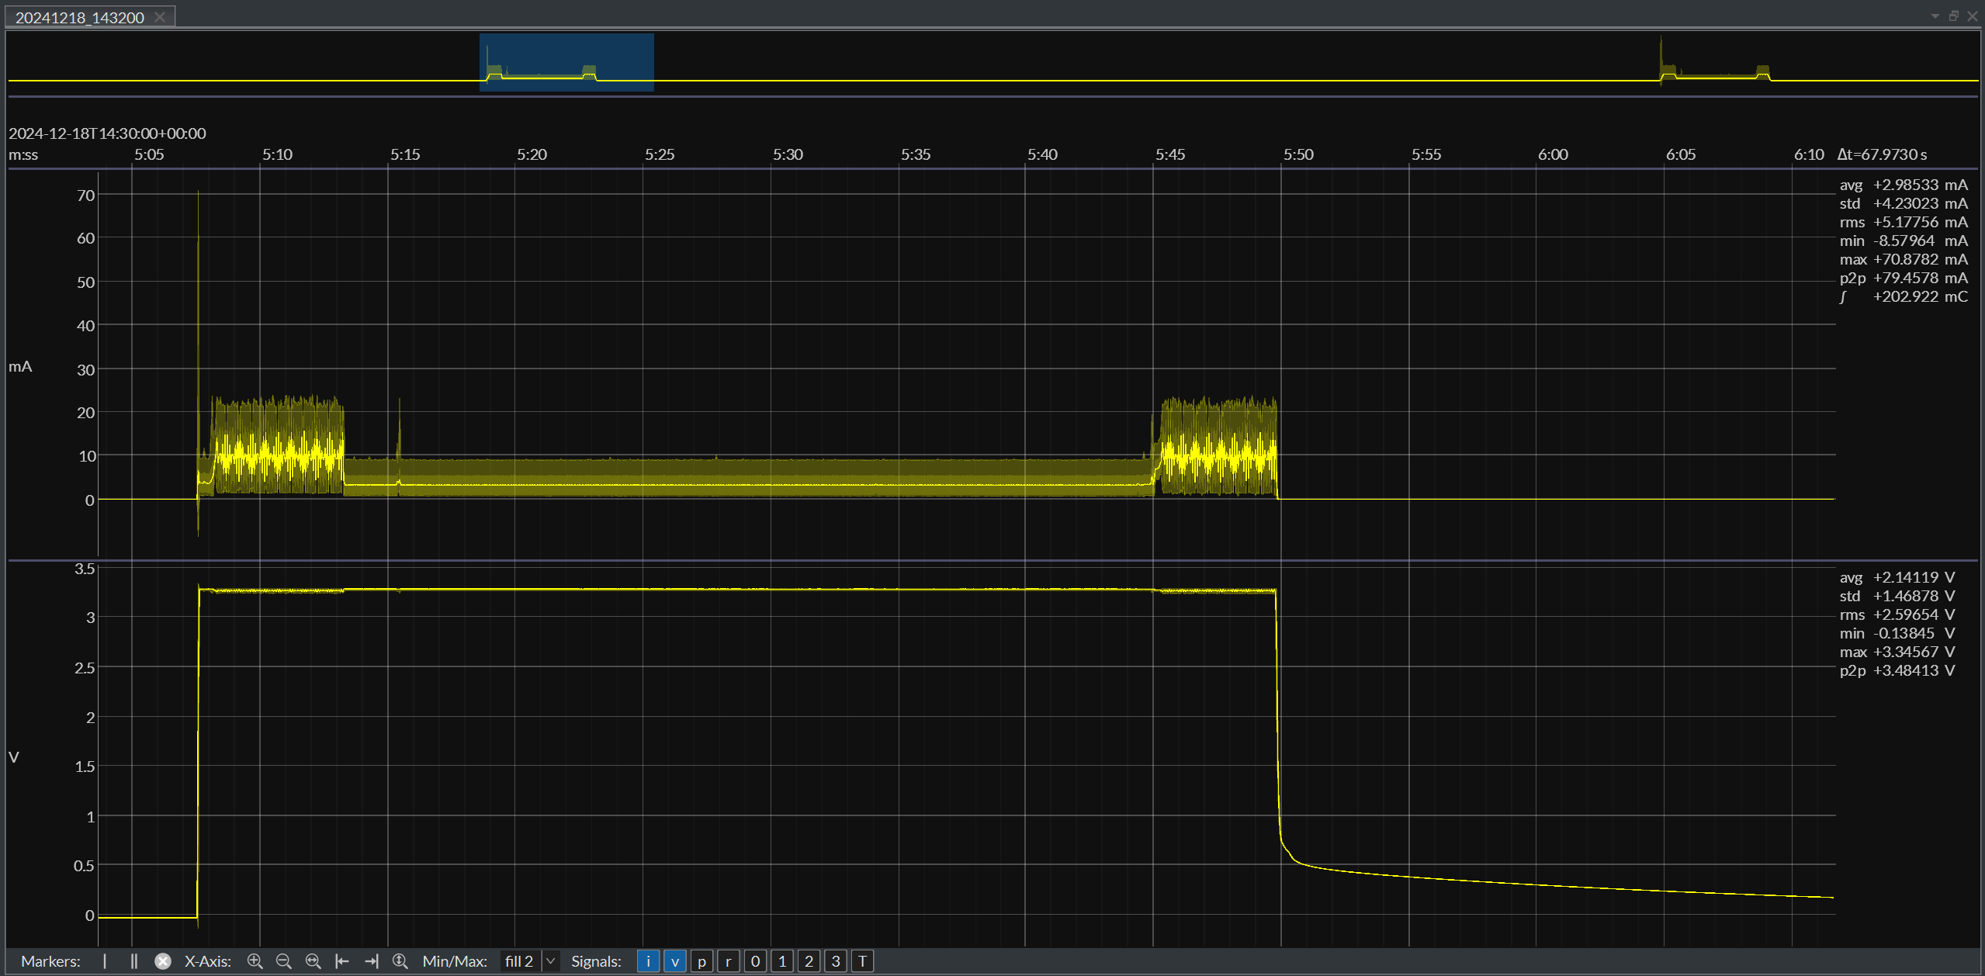
Voltage output measurement
Notes:
Here we can see that when the outpus opens BLE starts to scan for other rovers abound, it can be seen though power consuption.
The whole project module runs for 45 seconds ( enough for two scannings )

Slide 64
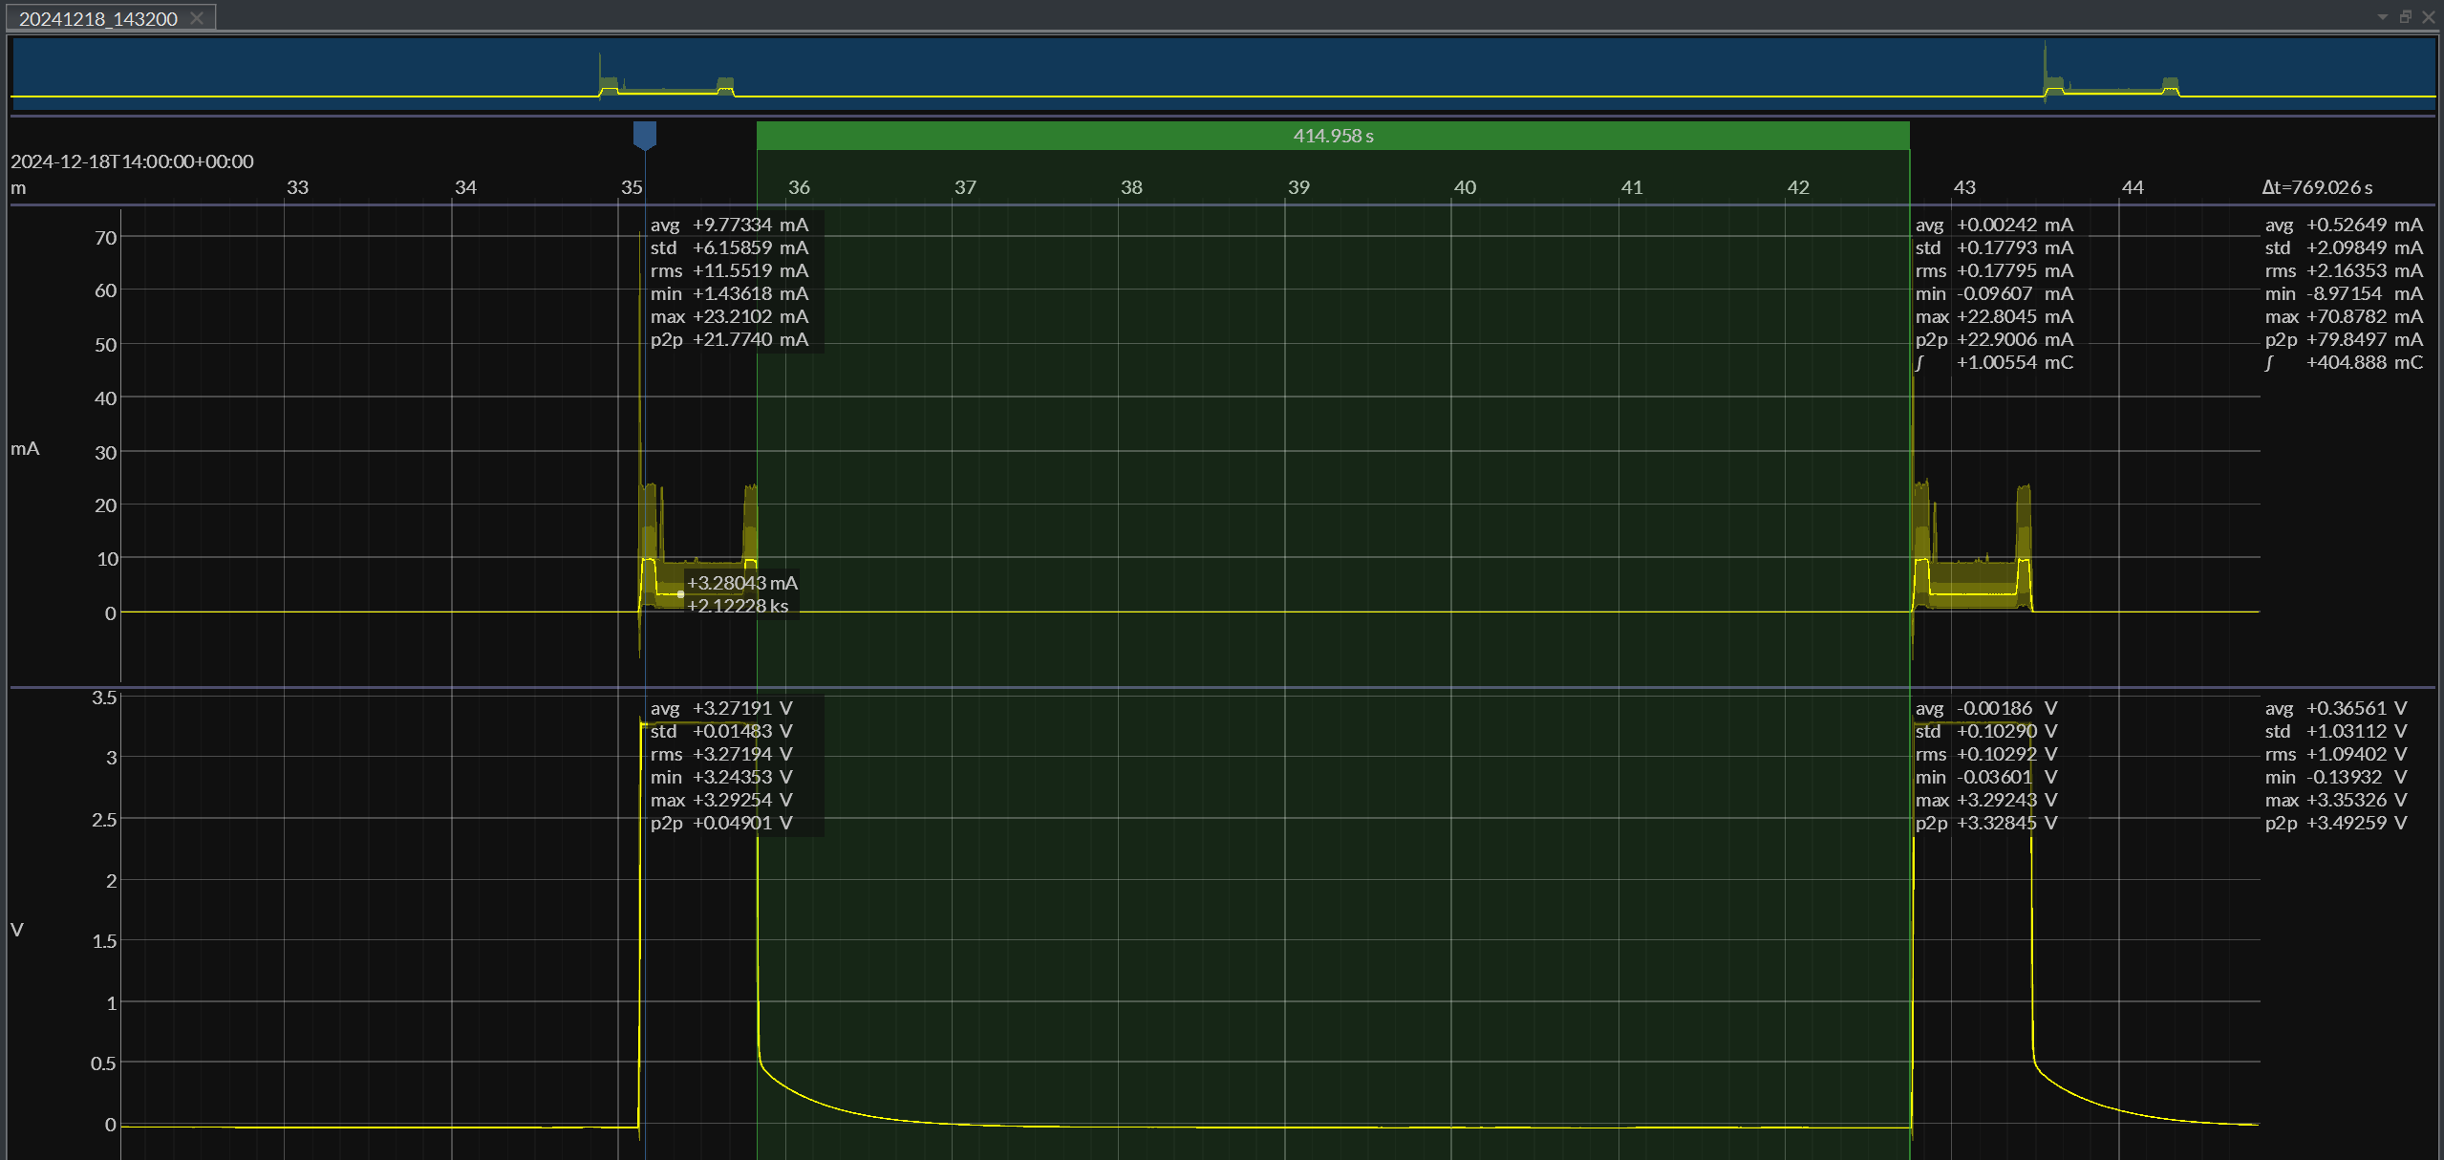
Voltage output measurement
Notes:
With current charging power of the inside solar panel it takes 7 minutes to charge the SuperCaps
until they exceed the Voltage for the Enegry harvesting module to open the output again.

Slide 65
The goal
SHT40(1.08 - 3.6)V
LTR-329(2.4 - 3.6)V
BLE(1.7 - 3.3)V
STM(3 - 3.6)V
Notes:
We want to power as many peripherals as possible
- Inside Solar Panel
- 2x 2,7V1F Supercap
- AEM10941 Evaluation Kit
We ended up using E.H.M. with one solar panel and two SuperCaps in series.
(Using two different solar panels can cause Current imbalance where "stronger" solar panel will force current to the weaker one, making the charging actually slower and could damage the system or the solar panels)
There is a bit of a problem with using two SuperCaps because of voltage division between them... but more on that later.

Slide 66
Power Profile
Notes:
Through the semester, we have taken various of measurement that where often not used due to code changes or even wrong setups.
Nevertheless, we assembled the good ones in a bar graph to impact the importance of setting registers.

Slide 67
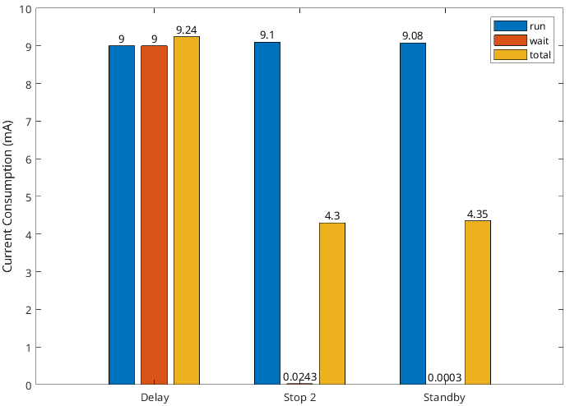
Power Profiling STM32
Notes:
Here is a bar chart of the power consumption of our brain module where we have 3 blocks:
Block 1 -> No OPeration commands.
Block 2 -> Stop mode 2 (has ram retention)
Block 3 -> Standby (no ram retention)
We can clearly see that in all blocks, the brain module in running mode consumes the same amount.
When brought into stop mode 2, which can easly be replaced by de default delay due to the fact that it has ram retention, in order to cut the power usage in half.
The standby mode looks to have less impact, but still, when looking at the numbers,
we roughly divide the power consumption by a factor 80. Side note, at standby, no ram retention is present, thus the MCU is resetted when powering up.

Slide 68
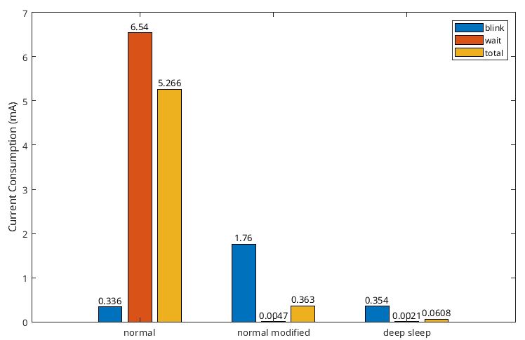
Power Profiling nRF52
Notes:
The same we did for our BLE-module.
Again we have 3 blocks,
Block 1 -> normal operation mode where no delays are used and the MCU is constantly processing
Block 2 -> Between each statement, a small delay is used to feed NOP's
Block 3 -> Deep sleep is enabled. No ram retention
In normal operation, the MCU has no time to let the Power Management Unit do its job as everything is in use.
In the normal modified, we have some gaps of delays where the PMU can step in and reduce power briefly. This briefly reduce, ensures a significant power reduction.
Side note: a higher consumption is measured in the blink part due to the mcu must enable everything which causes a spike in current consumption.
In the deep sleep mode, consumption is only halved and no ram retention is present.
The PMU plays a vital roll in this MCU.

Slide 69
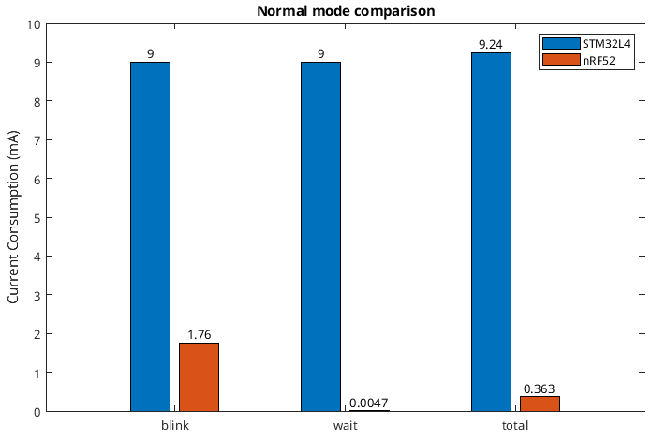
STM32L4 VS NRF52
Notes:
A small comparison between the STM32 and BLE-module in normal running mode with a delay. The power of the dynamically PMU-unit can be spotted here.
The same could be archieved in the STM32 but sadly, we didn't go that far.

Slide 70
NRF52 VS STM32L4
NRF52 better/ easier than STM32L4?
Notes:
But here, the question can be asked that this NRF52 is better or easier in use that the SMT32?
We do not know as we didn't experiment further with the STM32 power modes in depth.

Slide 71
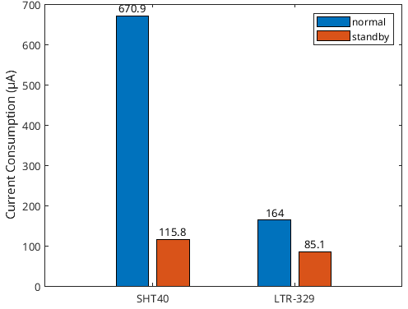
Power Profiling Sensor
Notes:
We reduced the energy consumption of our environment sensing sensord by putting them into standby mode. Still a high current consumption for standby.
Side note, on the module, a power indicator led is present. This could imply the higher current consumption.

Slide 72
Energy Awareness
Notes:
Energy awareness is implemented to preserve as much energy as possible and distribute it with care.

Slide 73

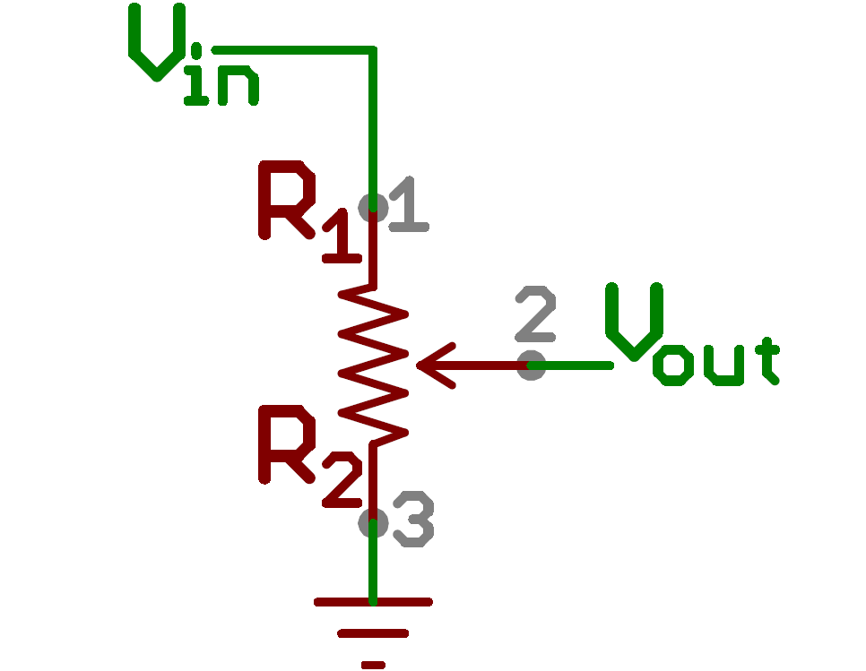
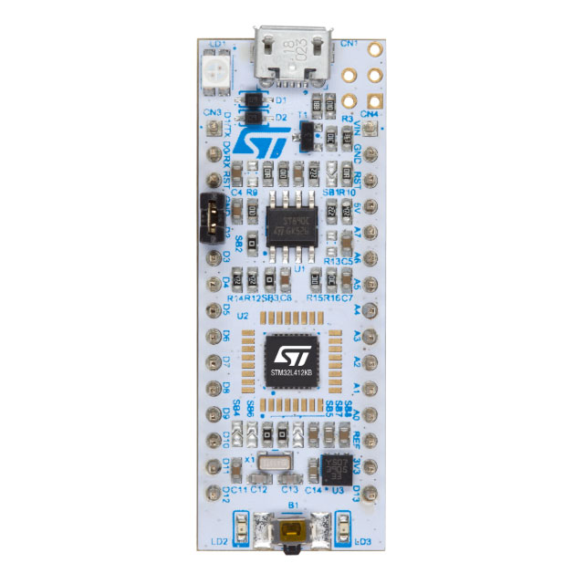
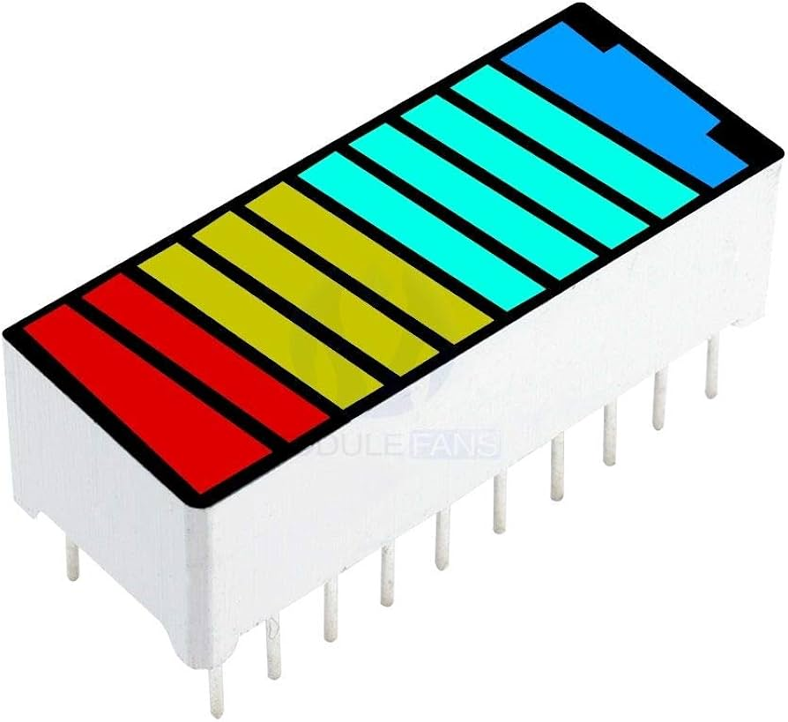
Energy Awareness
Simulation PMIC
ADC
Notes:
But first a sketch of our setup, in order to demonstrate our MVP, we will not use the PMIC, but we will mimic the supercaps voltage through a potentiometer.
We've added some leds so it is easly seen on sight how the supercaps' voltage is.

Slide 74
Energy Awareness
Optimal Task Schedule
Notes:
First we discuss optimal task schedule

Slide 75
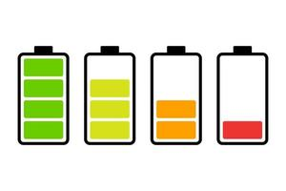
Energy Awareness
Sens
Store
Scan
Beacon
LoRa
Drive
Sleep
Sens
Sens
Store
Beacon
LoRa
Sleep
Sens
Store
Beacon
Sleep
Sleep
Notes:
When the battery is full, we can perform all our actions which include
Sensing the environment.
Storing the data in our local memory.
Scanning for beacons in our close proximity.
Beaconing so other rovers can detect us.
Send out a lora packet with the results of our sensing measurements.
Drive in a random way for a certain period in time.
And finally sleep.

Slide 76
Energy Awareness
Sens
Store
Scan
Beacon
LoRa
Drive
Sleep
Sens
Sens
Store
Beacon
LoRa
Sleep
Sens
Store
Beacon
Sleep
Sleep
Notes:
If the battery is ¾ of its capacity
We leave out the driving part

Slide 77
Energy Awareness
Sens
Store
Scan
Beacon
LoRa
Drive
Sleep
Sens
Sens
Store
Beacon
LoRa
Sleep
Sens
Store
Beacon
Sleep
Sleep
Notes:
If the battery is halfway, we only sens and beacon so surrounding rovers know there is a rover.

Slide 78
Energy Awareness
Sens
Store
Scan
Beacon
LoRa
Drive
Sleep
Sens
Sens
Store
Beacon
LoRa
Sleep
Sens
Store
Beacon
Sleep
Beacon
Sleep
Notes:
Lastly, if the battery is ¼, we only perform a beacon.

Slide 79
Energy Awareness
Optimal Transmission
Notes:
Optimal transmission is not included in our MVP but is certainly a topic for our further development. Let me elaborate on this.

Slide 80
Notes:
Think about Mars

Slide 81

Notes:
Ah wait, this is the wrong Mars

Slide 82
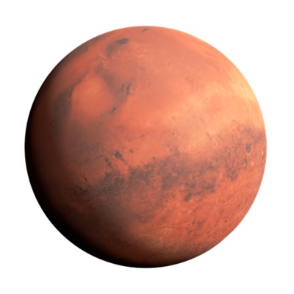
Notes:
Ah, Mars.
Here we have mars where a gateway is located somewhere on the planet.

Slide 83
Notes:
Lets assume we have 2 rovers wondering arround

Slide 84
Notes:
If they can transmit over LoRa, they will reach both the same gateway. The measurements that are conducted have meaning as they are recorded in different areas.

Slide 85
Notes:
What if both rovers meet each other on a distance where a beacon can be detected through a scanner.

Slide 86
Notes:
Both will transmit their recorded value over LoRa which will have the same value because it is recorded in close proximity. This extra data of 1 rover has no extra meaning.

Slide 87
Notes:
Therefore, to reduce power of 1 of the rovers, only 1 rover sends its value.
This can be determined on the voltage of the supercapacitor where a higher voltage means a better battery thus, more power available to transmit over LoRa.

Slide 88
Challenges

Slide 89
Adam Hejduk
Robbe Elsermans
Thomas Kramp
I2C protocol with sensors, HAL library and programming in general
This course has been a new experience !
Feels like I literally learned how to solder here
Reading
(human) communication
NRF SDK documentation
Tools
Defining propper objectives
Reading the docs takes time
Applying I2C support
Linebot (GPIO)
LoRaWAN (UART)
Keeping the LoRa module connected
MPU6050 power measurents

Slide 90
Learns

Slide 91
Learns
For all
mA is high current in LP environment
STM32 has powerful processor catalogue
STM32 has extensive examples
(Personally) STM32 outperforms Nordic Semiconductor documentations
Power Profiling is fun (with the right equipment)
Set a stable development environment up before coding
Have spares to test faults
...

Slide 92
Further Development

Slide 93
Further Development
Further optimize STM32 power usage
Use nRF SDK directly
Further optimize nRF52 power usage
Reprogram SEEED LoRa module (is STM32 based)
Use its build-in EEPROM
Orientation V2
Optimal Transmission algorithm
Find a replacement for the gyroscope measurements
4.5V to 5.7V custom E.H.M. configuration
Supercap equal voltage distribution

Slide 94



Slide 95
Demo

Slide 96
Demo
https://www.youtube.com/watch?v=zGMOyNRa958&ab_channel=RobbeElsermans

Slide 97
Appendix

Slide 98
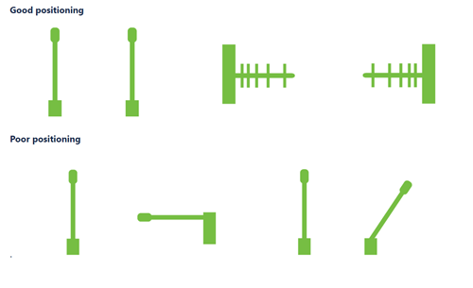
BLE Communication system
Orientation V2
Antenna relative placement
Notes:
We can use this intercommunication to determine the relative orientation of 2 independently driving rovers

Slide 99
References
https://www.istockphoto.com/fr/vectoriel/ic%C3%B4ne-noire-d%C3%A9nergie-solaire-gm1272457034-374723493
https://www.flaticon.com/free-icon/antenna_7021857
https://icon-icons.com/icon/potentiometer/4907
https://www.alamy.com/mars-rover-isolated-on-white-background-elements-of-this-image-were-furnished-by-nasa-high-quality-photo-image425822621.html
https://www.amazon.ca/Segment-Battery-Display-Indicator-Multi-Color/dp/B07S3NJCML
https://www.digikey.be/en/products/detail/stmicroelectronics/NUCLEO-L412KB/9656229
https://www.ram-center.com/blog/bluetooth-low-energy-interface-ble
https://www.mouser.be/new/powerfilm/powerfilm-solar-dev-kit-e-peas-cap-xx/
https://befr.rs-online.com/web/p/development-tool-accessories/2821454
https://nodered.org/about/resources/
https://www.thethingsnetwork.org/brand-assets/
https://learn.sparkfun.com/tutorials/voltage-dividers/all
https://www.vecteezy.com/free-vector/battery-icon
https://en.m.wikipedia.org/wiki/File:Mars.png
https://www.vecteezy.com/free-png/mars

Slide 100
BLE Communication system
Advertise -> IBeacon
UUID
MAJOR
TX Power @ 1m

Slide 101

Power Profiling STM32
Current Usage
Pseudo code
Notes:
Stop 2 – RTC by LSI 1.3µA != 24µA
Standby – RTC by LSI 330nA ~ 300nA
Running mode 9mA

Slide 102

Power Profiling nRF52
Current Usage
Pseudo code
Notes:
High Consumption -> PMU doesn't have any time
Standby – RTC by LSI 1.3µA != 24µA
system off– RTC by LSI 0.4µA != 2.1µA

Slide 103

Power Profiling Sensor
Current Usage
Pseudo code

Slide 104

BLE Communication system
Intercommunication
Overlap needed
2^n time differences
Guaranteed delivery
Test: 7% dropout (100)

Slide 105
Energy Awareness
Sens
Store
LoRa
Scan
Beacon
Drive
Sleep
Sens
Sens
Store
LoRa
Beacon
Sleep
Sens
Store
Beacon
Sleep
Sleep

Slide 106

MCU Pinout

Slide 107

Demonstration plan
Powering the STM with reliable source but have a potentiometer to shift the voltage of the circuit to simulate power levels of solar harvesting...
Depending on the levels of volatege available rover would/could do specific nubmer of tasks (task desicion making)
Therefore we are optimising a solution
to energy related decision making

Slide 108
Energy Harvesting Simulation
Simulation PMIC
ADC

Slide 109


